Slide 1
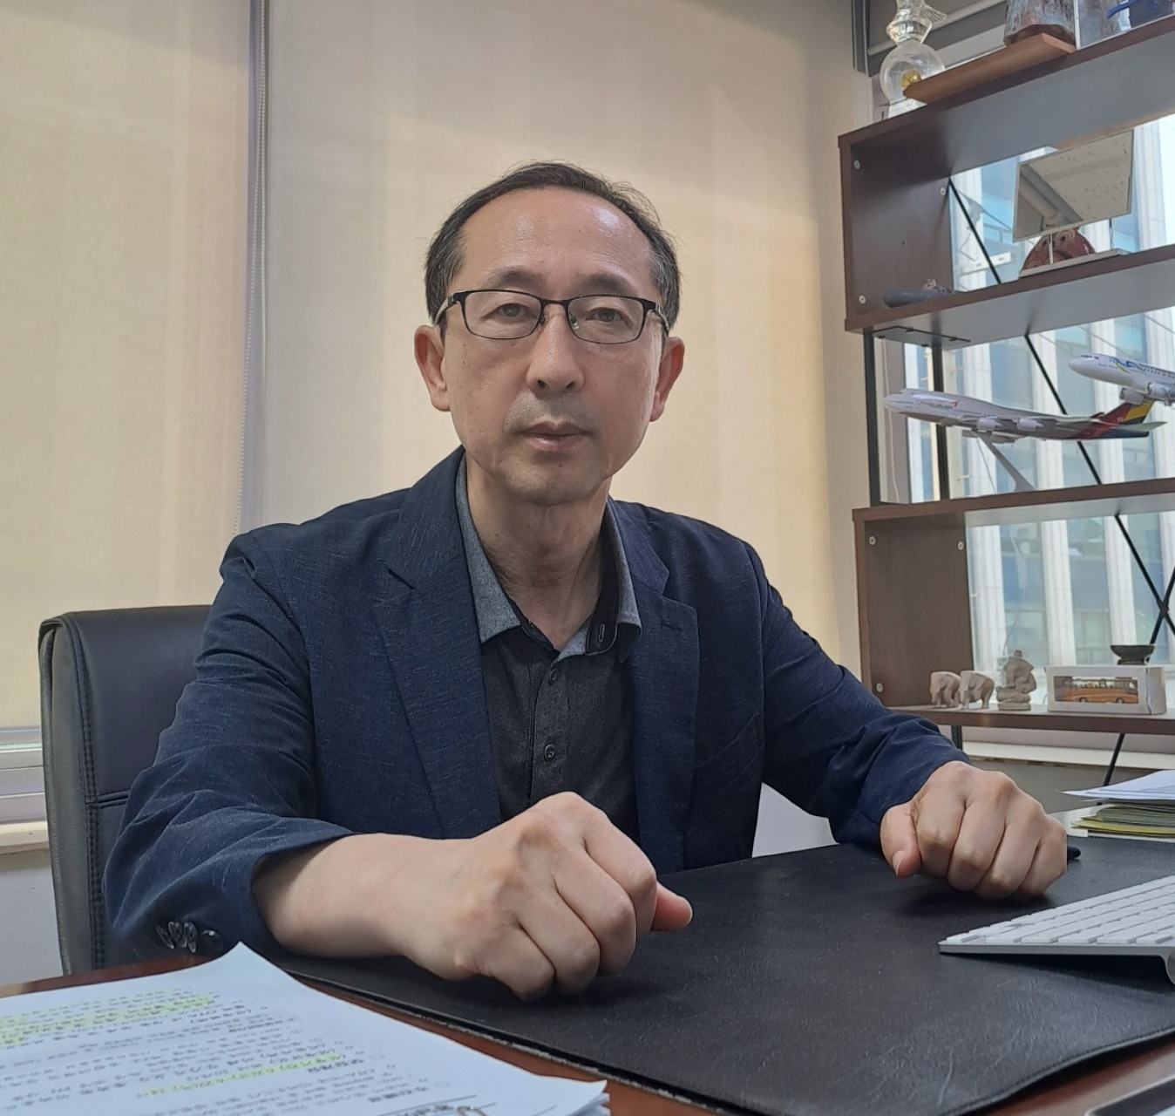


YOUR BEST
PARTNER
Direct Management in Southeast & Central Asia, Mongolia, Europe & Caucasus
Specialty Travel Agent

Slide 2

T & M TOUR
Table of Contents
I
01
COMPANY INTRODUCTION / GREETINGS
02
HISTORY
03
ORGANIZATION
04
T&M KEY COMPETENCES
06
II
T & M TOUR , AND A FAST-CHANGING TRAVEL INDUSTRY
01
KOREA TRAVEL MARKET
02
NEW PACKAGE TRAVEL & F I T
03
INDUSTRY CHANGES AFTER COVID-19
04
FOR SAFETY TRAVEL
05
T & M TOUR GROWTH STRATEGY
06
CONTACTS & LOCATIONS

Slide 3

OUR VISION
A COMPANY THAT CHANGES CURRENT TRAVEL PARADIGM FOR TRAVELERS TO EXPERIENCE THE DIFFERENT ASPECTS OF WORLD
T & M TOUR BUSINESS MODEL
ACCURATE TOUR GUIDANCE & CUSTOMER-BASED MANAGEMENT
TOUR PRODUCT COMPONENT
TOUR GUIDANCE
| PACKAGE TRAVEL|
| FIT TRAVEL |
TOURISTS & AGENCY
SATISFACTION

Slide 4

01. Greetings
T&M TOUR CO.,LTD
Starting with the establishment of its Singapore branch in 1998, T & M TOUR has not only recorded the highest number of outbound travelers among local travel agencies in Southeast Asia as of 2024, but has also expanded its business scope to Europe, Central/West Asia, Mongolia, and has grown to become a leader in the industry with direct local management offices in 14 locations in 16 countries.
In order to diversify our business and expand our base, we are the first in the travel industry to offer both outbound travel from Korea and inbound travel from Southeast Asia, developing travel products for various destinations and themes in line with the latest trends and customer needs. In addition, we are developing a variety of interesting travel products for our customers through continuous new product development, which is one of our core tasks, and will continue to strive to provide customers with more special and unique travel experiences.
Unlike the current situation where many local agencies operate in partnership with local partners, we directly operate local offices to secure high reliability of travel agencies and maximize customer satisfaction, and to break away from the inherent practices of travel industry and secure financial soundness. For this reason, we have been operating cleanly without any loans from local hotels or restaurants since the company was established.
We promise to prioritize customer value as a measure for ESG sustainable management and to become a travel agency that is consistent from the beginning to the end.
Thank you.
C.E.O
YOON, KWAN SIK

Slide 5

02. COMPANY HISTORY
Since 1998
SIEM RIP, CAMBODIA OFFICE ESTABLISHED
INBOUND CORPORTE [TOUR SEOUL KOREA CO., LTD] ESTABLISHED
TOUR & MEMBERS CO., LTD & SINGAPORE OFFICE ESTABLISHED
HANOI, VIETNAM OFFICE ESTABLISHED
HO CHI MINH, VIETNAM OFFICE ESTABLISHED
DA NANG, VIETNAM OFFICE ESTABLISHED
1998. 01.
2005. 10.
2005. 11.
2006. 10.
2010. 05.
2010. 06.
2019. 12.
2019. 01.
2018. 12.
2016. 08.
2013. 06.
2012. 08.
VLADIVOSTOK, RUSSIA OFFICE ESTABLISHED
NHA TRANG, VIETNAM OFFICE ESTABLISHED
CHIANG MAI, THAILAND OFFICE ESTABLISHED
LAOS OFFICE ESTABLISHED
JAKARTA, INDONESIA OFFICE ESTABLISHED
BANGKOK, THAILAND OFFICE ESTABLISHED
2022. 07.
2022. 10.
2023. 05.
2023. 07.
2023. 10.
ULAANBAATAR, MONGOLIA OFFICE ESTABLISHED
T AND M TOUR CO., LTD
CORPORATE INTEGRATED
(IN & OUTBOUND DIVISION INTEGRATION)
ROME, ITALY OFFICE ESTABLISHED
IATA® Travel Agent
OFFICIALLY APPROVED
Tashkent / Georgia /
Armenia OFFICE
ESTABLISHED

Slide 6

03. INBOUND DIVISION
Southeast Asia, North America, Europe & Middle East
SUCCESSFUL PKG / INCENTIVE /
CORPORATE /
VVIP EVENT
DIRECT-MANAGEMENT
LOCAL OFFICES
KOREA #1 INBOUND TRAVEL AGENCY
Main Performance
India YPO Gold Mumbai
VIP 100 PAX Secured
ITF International Tae-Kwon-do
Seoul Competition
* Over 600 PAX Secured *
Manulife Vietnam
423 PAX Secured
Brazil Medical Group
165 PAX Secured
2024. 04
2023. 09
2023. 05
2023. 05
2023. 02
2022. 06
2017. 05
2016. 09
Ford Vietnam
307 PAX Secured
Brazil Medical Group
180 PAX Secured
MD MEDIA INDONESIA
380 PAX Secured
Malaysia Prudential Group
860 PAX Secured

Slide 7
03. OUTBOUND DIVISION
T & M TOUR GLOBAL
SEOUL HQ
HANOI, VIETNAM
DA NANG
HO CHI MINH
NHA TRANG
VLADIVOKTOK
EUROPE
MONGOLIA
MATSUYAMA
NORTH AMERICA
(Under Review)
CAUCASUS
CENTRAL ASIA
UZ / KY / KZ
SEOUL HQ
LAOS
SRI LANKA &
MALDIVES
SOUTHEAST ASIA
Thailand / Singapore / Laos
Vietnam / Indonesia / Cambodia
VLADIBOSTOK
ULANBATAAR
TOTAL # OF STAFF
SEOUL HQ
KOREAN
ROME
LOCAL
INBOUND
DIVISION
OUTBOUND
DIVISION
500~
200~

Slide 8















03. OVERSEAS OFFICES
T & M TOUR GLOBAL
SEOULHQ
#B – 2F (GYEDONG BD), 104, BUKCHON-RO, JONGNO-GU, SEOUL 03051, KOREA (SOUTH)
Tel: 725-5595 Fax: 725-2932
DAEGU
#B – 2F (JONGGAK BD), 673, KOOKCHAE-BOSANG-RO, JUNG-GU, DAEGU, KOREA (SOUTH)
Tel: 053-255-5595
HANOI
Lo 105 , TT3 , Duong Hoang Trong Mau, Khu Do Thi My Dinh Song Da, Quan Nam Tu Liem, Ha Noi
Tel: 84-81-636-5712
DA NANG
181 Lê Quang Đạo, Bắc Mỹ Phú, Ngũ Hành Sơn, Đà Nẵng 550000
Tel: 84-094-308-1471
PHU QUOC
4XMM+R7M, Đường Bào, Phú Quốc, Kiên Giang (Phoenix villa)
-
NHA TRANG
Tang 7- Toa Nha VCN Phuoc Hai, So 2 To Huu, Nha Trang, Khanh Hoa
Tel: 84-904-364-100
BANGKOK
Shinnawat Thai Silk Building, Room 3/9 Soi. Sukhumvit 23, Sukhumvit Rd, Klongtoie-Neua,Watthana, Bangkok. Thailand. 10110.
Tel: 66-87-102-1900
CHIANG MAI
227/7 Mahidol Soi 1 A.Muang Chiang Mai 50000
Tel: 66-87-102-1900
SINGAPORE
133 New Bridge Rd, #10-04, Singapore 059413
Tel: 65-6438-5584
SIEM RIP
Canadia bank Bundle 4Floor Sivuthal Streed 1, Siem-Reap, Kingdom of Cambodia.
Tel: 855-17-619-069
JAKARTA
Saphungmor Village, Rue Lao-Thai Xaysetta District, Vientiane Capital,Lao PDR
Tel: 021-2112-6122
VLADIVOSTOK
Of.1112, bld. 11, Aleutskaya str. Vladivostok, Russia
Tel: +7 950-297-29-89
ULANBATAAR
306, City Plaza, 3rd Floor, Seoul Street, 1-r khoroo, Sukhbaatar District, Ulaanbaatar, Mongolia
Tel: +976-8066-3260
ROME
Via Gasperina 304, interno 16
Tel: +39 351-518-6691
PARIS
90 rue de la Victoire 75009 Paris
-
GEORGIA
Merab Kostava St. 47 Tbilisi, Georgia #31
Tel: +995 598-086-455
AZERBAIJAN
55 Rashid Behbudov St, Baku 1022 #9 #24
Tel: +99888130475
TASHKENT
Tashkent, Yashnabad Mumtoz 100a

Slide 9
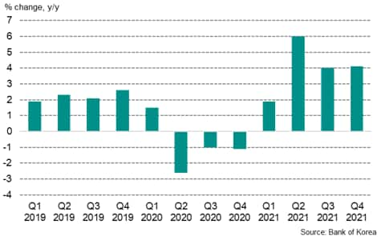
04. T&M KEY COMPETENCES
04.
COST COMPETENCE
INDUSTRY COMPETENCE
GLOBAL NETWORK
ACCURATE INFORMATION &
HAVE SPECIALTY ON REDUCING GROUND-FEE
Overwhelming market power and economic growth
The largest in the industry on building a Global Network
Changes in GDP of Korea
Credit : Government of Korea

Slide 10






04-I. COST COMPETITIVENESS
T&M TOUR ONLY AIR / HOTEL / PRODUCTS
OZ/TW : Combined Tour Guidance with Asiana & Tway Airlines
VN : Secured 7-800 seats connecting East Vietnam & Cambodia
YP : Europe Combined Tour Guidance
C7 : Central Asia (UZ / KY / KZ) & Caucasus Tour Guidance
HY : Secured 1,000+ seats connecting Central Asia region via Korea PSA Agreement
UL : Cheapest Tickets Acquired with Structured Business Relationship (ICN – CMB – MLE / ICN – CMB)
VIETNAM(NOR/MID/SOU): 80,666 PAX in past 5 yrs – ACQUIRED VARIOUS HOTELS FROM 3-5 STARS
THAILAND(BKK/PTY/LAOS) : 40,000 PAX in past 5 yrs – ACQUIRED VARIOUS HOTELS FROM 3-5 STARS
EUROPE : OVER 3,000 PAX since its office has opened in May 2023– ACQUIRED VARIOUS HOTELS FROM 3-5 STARS
SINGAPORE/MALAYSIA/INDONESIA : 150,996 PAX IN 2023 – ACQUIRED HOTELS IN SINGAPORE/VINTAN/BATAM
MONGOLIA / CENTRAL ASIA : ACQUIRED HOTELS FROM 3-5 STARS
CAUCASUS : ACQUIRED CHEAPEST TOUR FEE WITH DIRECT-MANAGEMENT OFFICES
SRI LANKA / MALDIVES : ACQUIRED 4-5 STAR HOTELS/RESORTS via Strategic global network
VIETNAM/THAILAND/SINGAPORE/MONGOLIA/ : EASY TO TRAVEL MAIN TOURIST PLACES & ATTRACTIONS
WE HAVE DIIRECT-MANAGED OVERSEAS OFFICES SO THAT WE CAN OPERATE VARIOUS TOUR EVENTS / PRODUCTS.
관광
T&M TOUR HAS A SPECIALTY COMPETENCE UNLIKE THE OTHER LOCAL TRAVEL AGENCIES.
WE CAN SAFELY MANAGE VARIOUS TOUR- FEE FROM “T&M ONLY CONTRACTED AIR, HOTEL & TOUR PRODUCTS” UNLIKE THE OTHER LOCAL TRAVEL AGENCIES. IN 2025 AND SO ON, FROM OUR TOUR FEE COST MANAGEMENT, WE WILL MAKE THE BEST OF BEST TOUR PRODUCTS PRICES DURING THE TRAVEL SEASON AND OFF-SEASON, WE WILL TRY OUR BEST TO MAKE TOUR EVENT MORE COST-EFFICIENT AND PROVIDES THE BEST TRAVEL EXPERIENCES.

Slide 11



04-II. COMPETITIVENESS
1
SECURED SPECIALTY ON ACCURATE INFORMATION IN LOCAL AREAS
2
SECURED COMPETITIVENESS ON HOTEL/RESORT
Strengthen competitiveness
3
SECURED VETERAN TOUR GUIDES & CUSTOMER-FIRST POLICY
4
SECURED SMOOTH COMMUNICATIONS AMONG KOREAN OFFICERS
5
CUSTOMER-BASED SERVICE MANAGEMENT
T&M TOUR
INT’L OFFICES
TOUR GUIDE
MOST VETERAN GUIDES
MONTHLY TOUR GUIDE SERVICE MANAGEMENT EXAM
RE-ASSIGN TOUR GUIDE FROM C USTOMER EXPERIENCE CENTER
MARKETING
HOME-SHOPPING PLAN
OPERATE YEARLY HOME-SHOPPING PLAN
NEWSPAPER PLAN
TRAVEL AGENCY NEWSPAPER ADVERTISEMENT
TOUR OPERATOR
ACCEPT & PROVIDE CUSTOMER OPINIONS IN VARIOUS TOUR OPTIONS (NO TIP, & MORE)
PROVIDE IMMEDIATE RESP-ONSE ON CUSTOMER COMPLAINTS
VIETNAM, NOR MID, SOU /
THAILAND, LAOS, SINGAPORE
JAKARTA, ROME, PARIS,
VLADIVOSTOK
GEORGIA, ARMENIA
14 NATIONS / 16 OFFICES
LOCAL DIRECT-MANAGEMENT

Slide 12

04-III. COST-COMPETITIVENESS
HOTEL
▶ LONG-TERM CONTRACTS WITH HOTELS & RESORTS
▶ SECURED PROMOTON PRICES ON NEWEST HOTELS
T&M TOUR’s EFFECTIVE COST-MANAGEMENT
BUS
▶ BUS PURCHASE (Direct Management)
▶ SPECIALTY ON BUS MANAGEMENT (LESS THAN 3 YEARS)
▶ TICKET PURCHASE SYSTEM IN LOW PRICES
(EX:NEGO-LAND, UNIVERSAL STUDIOS)
▶ VARIOUS OPTION PRODUCTS / IMPROVING CUSTOMER EXPERIENCES
PLACES
OTHERS
▶ PROMOTION WITH AIRLINES & NATIONAL TOUR ASSOCIATION
▶ VARIOUS TRAVEL PRODUCTS & SCHEDULE

Slide 13

04-IV. REDUCING COMPLAINTS
01
MONTHLY TOUR GUIDE EXAM
01
▶ TOUR OPERATION / CUSTOMER EXPERIENCE SURVEY
▶ TOUR GUIDE ASSIGNMENT / SELECTION
SYSTEMATIC
TOUR GUIDE
POLICY
▼
CUSTOMER SERVICE IMPROVEMENT
02
▶ GUIDE SELECTION POLICY / NO FREE GUIDE
▶ MAINTAINA A CONSTANT TOUR PRODUCTS
04
QUICK COMPLAINT SOLUTION
02
TOUR GUIDE SELECTION
03
▶ DOUBLE-CHECK THE TOUR SCHEDULE (ACCURATE HOTELS / REST.)
▶ VARIOUS OPTION LISTS & ITS HONEST PRICES
▶ CUSTOMER-BASED OPERATION & MANAGEMENT
04
▶ SECURED SYSTEMATIC COMPLAINTS PREVENTION SYSTEM
→ PROCESS BASED ON TOUR GUIDE POLICY
▶ QUICK SOLUTION IN LOCAL OFFICES
→ PREVENT UPCOMING COMPLAINTS
03
CUSTOMER-BASED TOUR
OPERATION

Slide 14
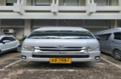
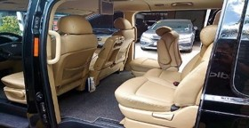
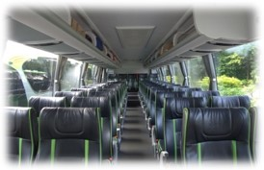
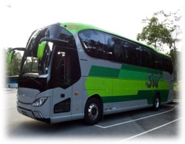
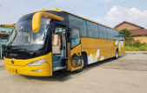
04-IIV. 2025 LOCAL VANS/BUSES
We’ve secured various kinds of vans & buses for tour operations.
▼
TYPES / COUNTRY | VIETNAM | THAILAND | LAOS | INDONESIA | MALAYSIA | SINGAPORE
VIP VANS | 77 | 121 | 70 | 67 | 88 | 70
MINI VANS (10-20) | 151 | 85 | 72 | 54 | 22 | 86
MID-SIZED (15-30) | 133 | 77 | 68 | 97 | 38 | 74
30-60 PAX. BUS | 150 | 123 | 95 | 103 | 47 | 126
MONGOLIA / CENTRAL ASIA / SRI LANKA | EUROPE / CAUCASUS
VIP VANS | VIP VANS
MINI VANS / BUS | MINI – LARGE BUSES
45- PAX. BUS | L.D.C (Long-distance Coach)
▶ The number of vehicles may be vary depend on the contracts with bus agencies.

Slide 15
05. SALES & PASSENGERS DATA
Credit : T&M Tour Financial Data
OUTBOUND DIVISION

Slide 16
05. SALES & PASSENGERS DATA
Credit : T&M Tour Financial Data
INBOUND DIVISION

Slide 17
Outbound Package Travel
- Across the world
Air Ticket Reservation
– IATA Approved Travel Agent
Outbound FIT TRAVEL
- Across the world
Specialized in
Inbound Travel Business for foreigners
Establishing and strengthening good relationships with domestic and overseas travel agencies & partners
Total Travel Service
In & Outbound Travel
Experienced Tour Guides
- Over 20-years / Specialized in package travel with no complaints
The BEST
HOTEL & RESORTs, Tour Buses,
& Reservation rate in the industry
INCENTIVE TRAVEL
- Corporate, Package, Study, & Cruise

Slide 18
II. T&M TOUR & A FAST-CHANGING TRAVEL INDUSTRY
Direct Management in Southeast & Central Asia, Mongolia, Europe & Caucasus
Specialty Travel Agent

Slide 19


01. KOREA TRAVEL MARKET
FROM 2017 TO 2025, IN & OUTBOUND TRAVELERS CONSTANTLY ROSE.
AFTER COVID-19, MORE PEOPLE ARE WANTING TO TRAVEL ABROAD WITH A LUXURY.
OUTBOUND
TRAVEL
NUMBER OF OUTBOUND TRAVELLERS
Credit : KATA
Per person : 1M
 | 2017 | 2018 | 2019 | 2020 | 2021 | 2022 | 2023
Departure | 2,649.6 | 2,869.6 | 2,874.4 | 427.6 | 122.3 | 666.4 | 2271.5
Increasing Rate(%) | 18% | 18% | 0% | -86% | -71% | 436% | 450%

Slide 20
02. NEW PACKAGE TRAVEL & FIT
AMONG THE YOUNGSTERS, TRAVEL TYPES BECAME DIVERSE AND THERE’RE MANY PEOPLE WANTING TO TRAVEL INDEPENDENTLY.
AFTER COVID-19, PACKAGE TRAVEL BECAME DIVERSE FROM NO-OPTION TO LUXURY TRAVEL.
Free
Independent
Tour

Slide 21
03. INDUSTRY CHANGES IN POST-COVID
Specialized Travel – A rise of specialized travel such as luxury and FIT travel types
Value Consumers – A high demand of luxury travel
Small-sized Travel – A high demand of small-sized travel with family and friends
Safe Travel – A high consideration of safety and sanitary after COVID
Uncontacted Channel – A high interest on uncontacted channel, such as home-shopping and online shopping.
THE 5
TRAVEL
TRENDS
We, T & M TOUR, are proactively preparing for the changes in the existing travel industry brought by COVID-19 and doing our utmost to ensure customer satisfaction.

Slide 22

04. FOR SAFETY TRAVEL
SAFETY
▶ Double-Check bus safety before moving
▶ If there’s an accident → We’re replacing to our other alliance bus in 1 hour
▶ Require 10 min. break to drive 1 hour
Risk
Prevention
▶ The tour guide check every time on the bus
▶ T/C will also caring safety with the tour guide
▶ T/A Travel Agent Professional Liability Insurance Acquired (F-22KA-TA00029)
For
Emergency
▶ The tour bus will accompany to go to hospital nearby
▶ All fees related accident will be paid by us (if with insurance)
▶ Notifying to OP directly when an accident occurs

Slide 23
05. T & M GROWTH STRATEGY
①
▶ SECURED TOUR OPERATIONS COMPETENCY
▶ UNLIKE EXPENSIVE TOUR FEES, WE MAKE TRAVEL MORE EFFICIENTLY
▶ CHECK CUSTOMER EXPERIENCES EVERY WEEK
②
▶ SECURED LOCAL & GLOBAL NETWORKS
▶ STRENGTHEN STRATEGIC PARTNERSHIPS WITH BUSINESS PARTNERS BY MAINTAINING ONGOING COOPERATION WITH NUMEROUS TRAVEL CLIENTS
③
▶ SECURED UNCONTACTED CHANNEL BASED ON THE TRAVEL TRENDS
▶ DIVERSIFY TRAVEL PRODUCTS BASED ON THE TRAVEL TRENDS
▶ SECURED UNCONTACTED CHANNEL WITH HOME-SHOPPING & FIT TRAVEL

Slide 24
WE WILL INSPIRE THE WORLD
T&M TOUR CO., LTD
In last 25 years, T&M TOUR has led the travel industry and we will continue to grow based on our experience and history.
We will become the leading travel agency, ensuring the safety capture of the explosive travel demand after COVID-19 pandemic.
Thank you.

Slide 25












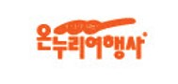




OFFICIAL PARTNER
INTERNATIONAL PARTNERS
BUSINESS PARTNERS

Slide 26
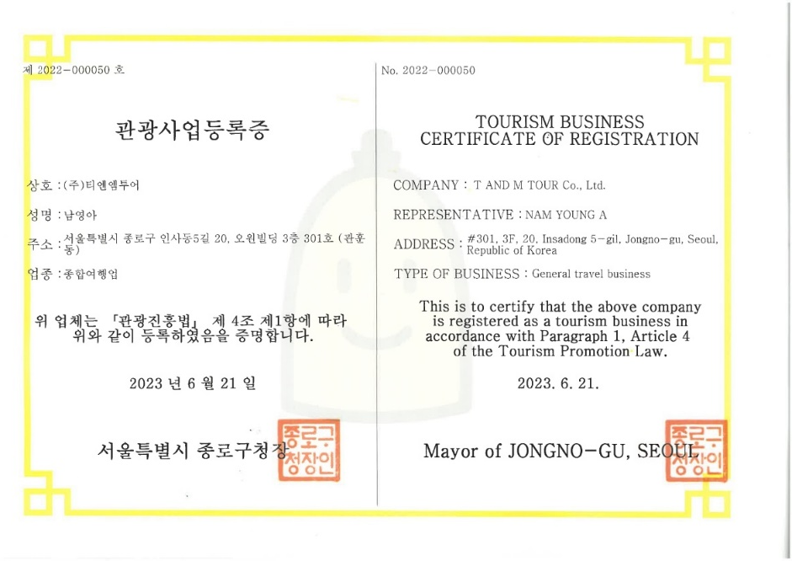
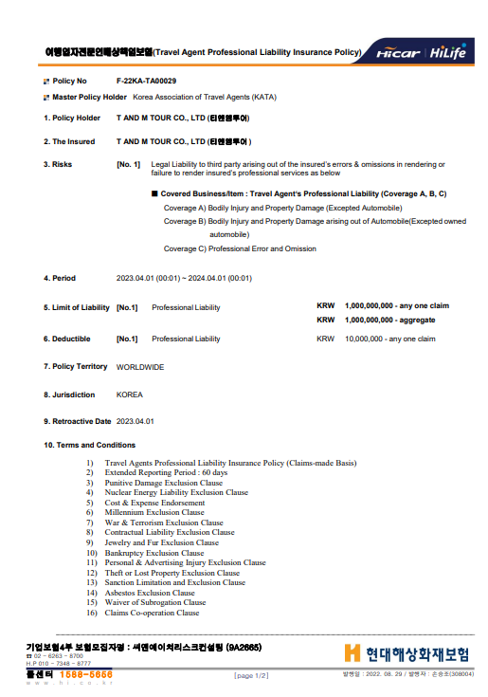
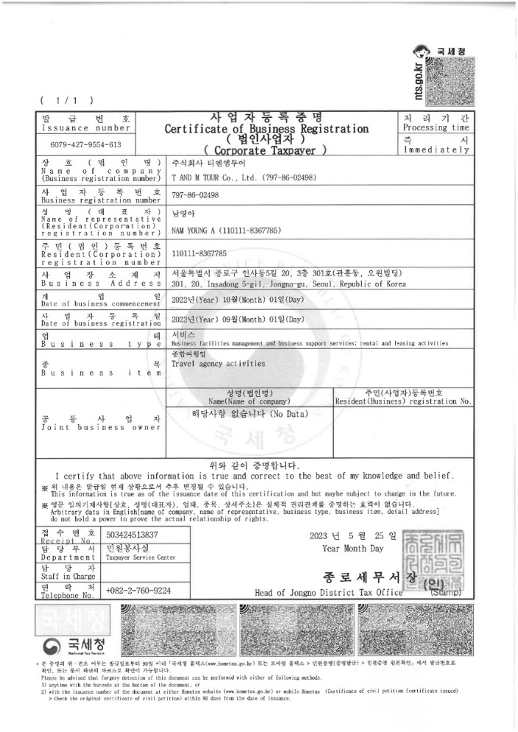
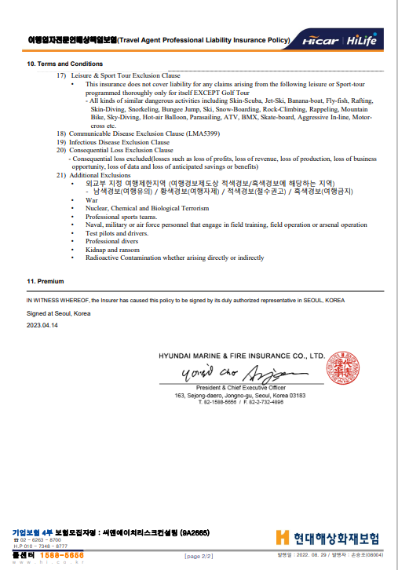
ENCLOSURE
Travel Agent
Professional Liability Insurance
MAX. $1,000,000 INSURED

Slide 27
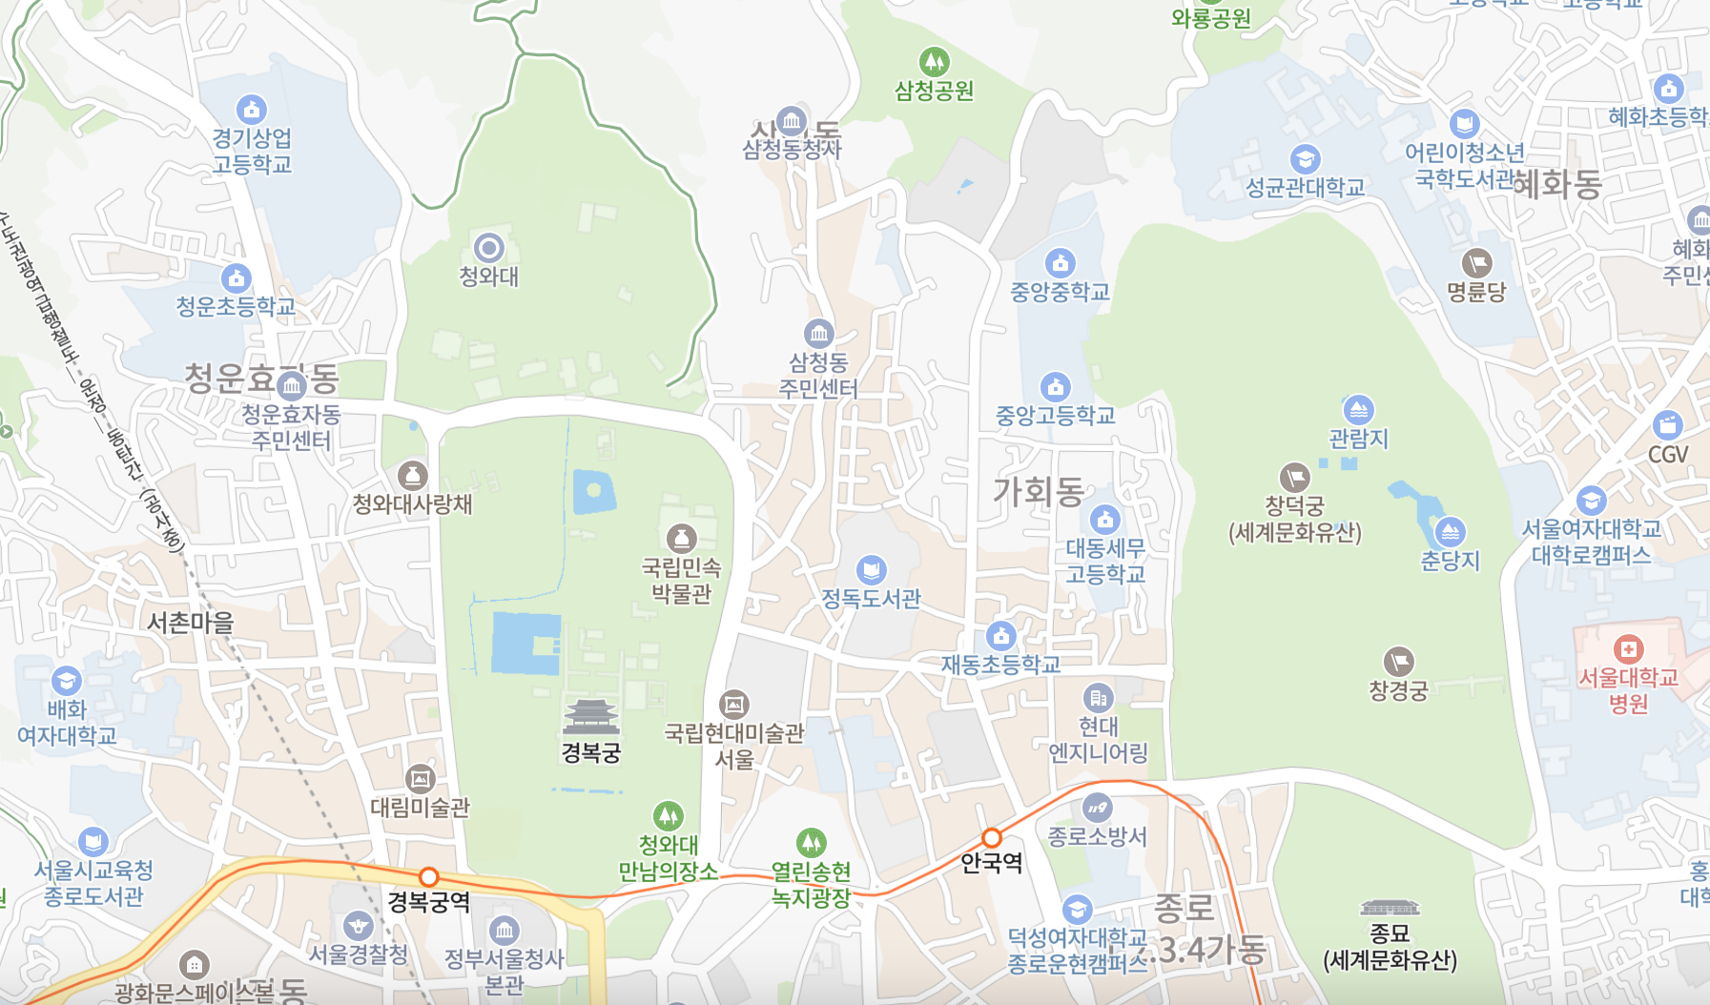
CONTACT US
SEOUL HQ | ADD. | #B, 2F, GYEDONG BUILDING 104, BUKCHON-RO, JONGNO-GU SEOUL 03051, REPUBLIC OF KOREA
 | TEL TRANS. | TEL: 02-725-5595 FAX: 02-725-2932 SUBWAY LINE #3 ANGUK STATION EXIT 2 TO 700M NEAR SAMCHUNG-DONG POST OFFICE

Slide 28


| T AND M TOUR CO., LTD. | 104, BUKCHON-RO, JONGNO-GU, SEOUL 03051, ROK (#B, 2F, GYEDONG BD) | TEL. 02-725-5595 |

